Slide 1
Linear Algebra

Slide 2
What is Linear Algebra
Linear algebra is central to almost all areas of mathematics. For instance, linear algebra is fundamental in modern presentations of geometry, including for defining basic objects such as lines, planes and rotations.
Also, functional analysis, a branch of mathematical analysis, may be viewed as basically the application of linear algebra to spaces of functions.
Linear algebra is also used in most sciences and fields of engineering, because it allows modeling many natural phenomena, and computing efficiently with such models.
For nonlinear systems, which cannot be modeled with linear algebra, it is often used for dealing with first-order approximations, using the fact that the differential of a multivariate function at a point is the linear map that best approximates the function near that point.

Slide 3
What is Linear Algebra
•
Linear algebra is the branch of mathematics concerning linear equations such as:
•
linear maps such as:
and their representations in vector spaces and through matrices.

Slide 4
Numerical Linear Algebra
The application of linear algebra in computers is often called numerical linear algebra.
It is more than just the implementation of linear algebra operations in code libraries; it also includes the careful handling of the problems of applied mathematics, such as working with the limited floating point precision of digital computers.
Computers are good at performing linear algebra calculations, and much of the dependence on Graphical Processing Units (GPUs) by modern machine learning methods such as deep learning is because of their ability to compute linear algebra operations fast.

Slide 5
Linear Algebra and Statistics
Some clear fingerprints of linear algebra on statistics and statistical methods include:
Use of vector and matrix notation, especially with multivariate statistics.
Solutions to least squares and weighted least squares, such as for linear regression.
Estimates of mean and variance of data matrices.
The covariance matrix that plays a key role in multinomial Gaussian distributions.
Principal component analysis for data reduction that draws many of these elements together.

Slide 6

Applications of Linear Algebra
Matrices in Engineering, such as a line of springs.
Graphs and Networks, such as analyzing networks.
Markov Matrices, Population, and Economics, such as population growth.
Linear Programming, the simplex optimization method.
Fourier Series: Linear Algebra for functions, used widely in signal processing.
Linear Algebra for statistics and probability, such as least squares for regression.
Computer Graphics, such as the various translation, rescaling and rotation of images.

Slide 7
Linear Algebra in Machine Learning
1. Dataset and Data Files
2. Images and Photographs
3. One Hot Encoding
4. Linear Regression
5. Regularization
6. Principal Component Analysis
7. Singular-Value Decomposition
8. Latent Semantic Analysis
9. Recommender Systems
10. Deep Learning

Slide 8
Example
Practical with NumPy

Slide 9
Vector
A vector is a tuple of one or more values called scalars.
Vectors are built from components, which are ordinary numbers.
You can think of a vector as a list of numbers, and vector algebra as operations performed on the numbers in the list.
Reference: No Bullshit Guide To Linear Algebra, 2017

Slide 10
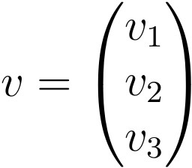
Vector
Vectors are often represented using a lowercase character such as v; for example:
v = (v1 , v2 , v3 )
Where v 1 , v 2 , v 3 are scalar values, often real values.
Vectors are also shown using a vertical representation or a column; for example:

Slide 11
Vector
It is common to represent the target variable as a vector with the lowercase y when describing the training of a machine learning algorithm.
It is common to introduce vectors using a geometric analogy, where a vector represents a point or coordinate in an n-dimensional space, where n is the number of dimensions, such as 2.
The vector can also be thought of as a line from the origin of the vector space with a direction and a magnitude.

Slide 12
Vector Arithmetic
Addition
Two vectors of equal length can be added together to create a new third vector.
c = a + b
The new vector has the same length as the other two vectors.
Each element of the new vector is calculated as the addition of the elements of the other vectors at the same index; for example:
c = (a1 + b1, a2 + b2, a3 + b3 )

Slide 13
Vector Arithmetic
Addition
Putting another way, c[0] = a[0] + b[0]
c[1] = a[1] + b[1]
c[2] = a[2] + b[2]

Slide 14
Vector Arithmetic
Subtraction
One vector can be subtracted from another vector of equal length to create a new third vector.
c = a − b
As with addition, the new vector has the same length as the parent vectors and each element of the new vector is calculated as the subtraction of the elements at the same indices.
c = (a₁ − b₁ , a₂ − b₂ , a₃ − b₃ )

Slide 15
Vector Arithmetic
Subtraction
Put another way: c[0] = a[0] − b[0]
c[1] = a[1] − b[1]
c[2] = a[2] − b[2]

Slide 16
Vector Arithmetic
Multiplication
Two vectors of equal length can be multiplied together.
c = a × b
As with addition and subtraction, this operation is performed element-wise to result in a new vector of the same length.
c = (a₁ × b₁ , a₂ × b₂ , a₃ × b₃ ) or c = (a₁b₁ ,a₂b₂ , a₃b₃ )

Slide 17
Vector Arithmetic
Multiplication
Put another way: c[0] = a[0] × b[0]
c[1] = a[1] × b[1]
c[2] = a[2] × b[2]

Slide 18

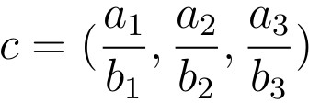
Vector Arithmetic
Division
Two vectors of equal length can be divided.
As with other arithmetic operations, this operation is performed element-wise to result in a new vector of the same length.

Slide 19
Vector Arithmetic
Division
Put another way:. c[0] = a[0]/b[0]
c[1] = a[1]/b[1]
c[2] = a[2]/b[2]

Slide 20
Vector Arithmetic
Dot Product
We can calculate the sum of the multiplied elements of two vectors of the same length to give a scalar.
This is called the dot product, named because of the dot operator used when describing the operation.
The dot product is the key tool for calculating vector projections, vector decompositions, and determining orthogonality.
The name dot product comes from the symbol used to denote it.
c = a · b

Slide 21
Vector Arithmetic
Dot Product
The operation can be used in machine learning to calculate the weighted sum of a vector.
The dot product is calculated as follows:
c = (a₁ × b₁ + a₂ × b₂ + a₃ × b₃ )
or
c = (a₁b₁ + a₂b₂ + a₃b₃ )

Slide 22
Vector Arithmetic
Scalar Multiplication
A vector can be multiplied by a scalar, in effect scaling the magnitude of the vector. To keep notation simple, we will use lowercase s to represent the scalar value.
c = s × v or c = sv
The multiplication is performed on each element of the vector to result in a new scaled vector of the same length.
c = (s × v₁ , s × v₂ , s × v₃ )

Slide 23
Vector Norm
Calculating the length or magnitude of vectors is often required either directly as a regularization method in machine learning, or as part of broader vector or matrix operations.
The length of the vector is referred to as the vector norm or the vector’s magnitude.
The length of a vector is a nonnegative number that describes the extent of the vector in space, and is sometimes referred to as the vector’s magnitude or the norm.

Slide 24
Vector Norm
The length of the vector is always a positive number, except for a vector of all zero values.
It is calculated using some measure that summarizes the distance of the vector from the origin of the vector space.
For example, the origin of a vector space for a vector with 3 elements is (0, 0, 0).
Notations are used to represent the vector norm in broader calculations and the type of vector norm calculation almost always has its own unique notation.

Slide 25
Vector L¹ Norm
The length of a vector can be calculated using the L¹ norm, where the 1 is a superscript of the L.
The notation for the L 1 norm of a vector is ||v|| 1 , where 1 is a subscript.
As such, this length is sometimes called the taxicab norm or the Manhattan norm.
L¹ (v) = ||v|| ₁

Slide 26
Vector L¹ Norm
The L¹ norm is calculated as the sum of the absolute vector values, where the absolute value of a scalar uses the notation |a₁|.
In effect, the norm is a calculation of the Manhattan distance from the origin of the vector space.
||v|| ₁ = |a₁ | + |a₂ | + |a₃ |

Slide 27
Vector L² Norm
The length of a vector can be calculated using the L² norm, where the 2 is a superscript of the L.
The notation for the L 2 norm of a vector is ||v|| 2 where 2 is a subscript.
L² (v) = ||v||₂

Slide 28

Vector L² Norm
•
The L² norm calculates the distance of the vector coordinate from the origin of the vector space.
As such, it is also known as the Euclidean norm as it is calculated as the Euclidean distance from the origin.
The result is a positive distance value. The L² norm is calculated as the square root of the sum of the squared vector values.
•
•

Slide 29
Matrix
•
Matrices are a foundational element of linear algebra.
Matrices are used throughout the field of machine learning in the description of algorithms and processes such as the input data variable (X) when training an algorithm.
A matrix is a two-dimensional array of scalars with one or more columns and one or more rows.
A matrix is a two-dimensional array (a table) of numbers.
•
•
•

Slide 30
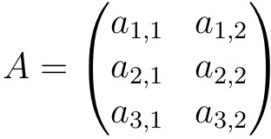
Matrix
•
The notation for a matrix is often an uppercase letter, such as A, and entries are referred to by their two- dimensional subscript of row (_{i}) and column (_{j}), such as
ªi,j .
For example, we can define a 3-row, 2-column matrix: A = ((a_{1,1} , a_{1,2} ), (a_{2,1} , a_{2,2} ), (a_{3,1} , a_{3,2} ))
It is more common to see matrices defined using a horizontal notation.
•
•

Slide 31
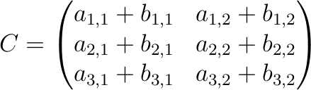
Matrix Arithmetic
•
•
Matrix Addition
Two matrices with the same dimensions can be added together to create a new third matrix.
C = A + B
The scalar elements in the resulting matrix are each of the matrices being added.
•

Slide 32
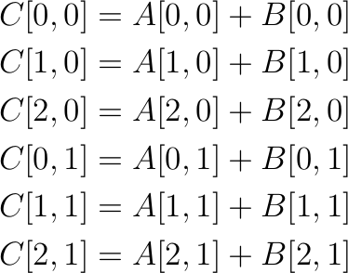
Matrix Arithmetic
•
•
Matrix Addition
Another way-

Slide 33

Matrix Arithmetic
•
•
Matrix Subtraction
Two matrices with the same dimensions can be subtracted together to create a new third matrix.
C = A – B
The scalar elements in the resulting matrix are each of the matrices being subtracted.
•

Slide 34
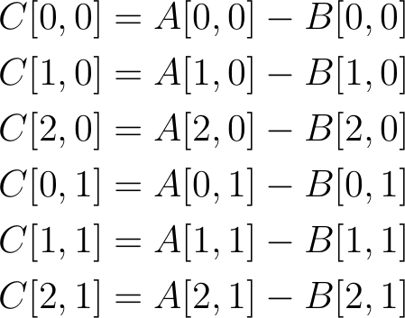
Matrix Arithmetic
•
•
Matrix Subtraction
Another way-

Slide 35

Matrix Arithmetic
•
•
Matrix Multiplication (Hadamard Product)
Two matrices with the same size can be multiplied together, and this is often called element-wise matrix multiplication or the Hadamard product.
It is not the typical operation meant when referring to matrix multiplication, therefore a different operator is often used, such as a circle ◦.
C = A ◦ B
•

Slide 36

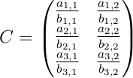
Matrix Arithmetic
•
•
Matrix Division
One matrix can be divided by another matrix with the same dimensions.
•
The scalar elements in the resulting matrix are calculated as the division of the elements in each of the matrices.

Slide 37
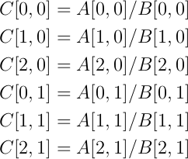
Matrix Arithmetic
•
•
Matrix Division
Put another way-

Slide 38
Matrix Arithmetic
•
•
Matrix-Matrix Multiplication
Matrix multiplication, also called the matrix dot product is more complicated than the previous operations and involves a rule as not all matrices can be multiplied together.
C = A · B or C = AB
The rule for matrix multiplication is as follows:
The number of columns (n) in the first matrix (A) must equal the number of rows (m) in the second matrix (B).
•
•

Slide 39
Matrix Arithmetic
•
•
Matrix-Matrix Multiplication
For example, matrix A has the dimensions m rows and n columns and matrix B has the dimensions n and k.
The n columns in A and n rows in B are equal.
The result is a new matrix with m rows and k columns.
C(m, k) = A(m, n) · B(n, k)
This rule applies for a chain of matrix multiplications where the number of columns in one matrix in the chain must match the number of rows in the following matrix in the chain..
•
•

Slide 40
Matrix Arithmetic
•
•
Matrix-Vector Multiplication
A matrix and a vector can be multiplied together as long as the rule of matrix multiplication is observed.
Specifically, that the number of columns in the matrix must equal the number of items in the vector. As with matrix multiplication, the operation can be written using the dot notation. Because the vector only has one column, the result is always a vector.
c = A · v or c = Av
•

Slide 41
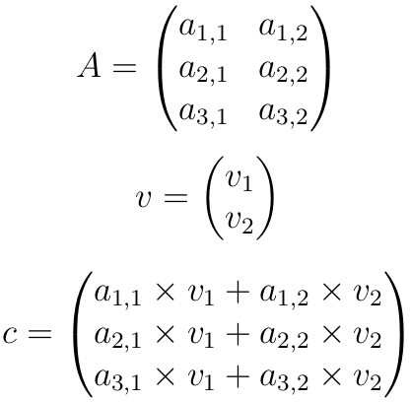

Matrix Arithmetic
•
•
Matrix-Vector Multiplication
The result is a vector with the same number of rows as the parent matrix.

Slide 42
Matrix Arithmetic
Matrix-Scalar Multiplication
A matrix can be multiplied by a scalar.
This can be represented using the dot notation between the matrix and the scalar.
C = A · b
Or without the dot notation.
C = Ab

Slide 43
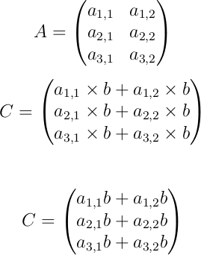
Matrix Arithmetic
•
•
Matrix-Scalar Multiplication
The result is a matrix with the same size as the parent matrix where each element of th matrix is multiplied by the scalar value.

Slide 44
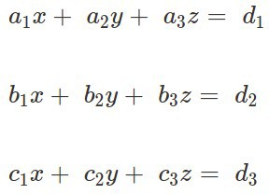
Linear Equations using Matrix

Slide 45
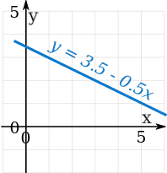
System of Linear Equations
•
•
y = mx + c
A linear equation is not always in the form y = 3.5 − 0.5x,
It can also be like y = 0.5(7 − x) Or like y + 0.5x = 3.5
Or like y + 0.5x − 3.5 = 0 and more.
(Note: those are all the same linear equation!)
•
•
•
•

Slide 46
System of Linear Equations
•
A System of Linear Equations is when we have two or more linear equations working together.
Example: Here are two linear equations:
•
2x | + | y | = | 5
−x | + | y | = | 2
•
•
Together they are a system of linear equations.
Can you discover the values of x and y yourself? (Just have a go, play with them a bit.)

Slide 47
System of Linear Equations
•
•
Let's try to build and solve a real world example: Example: You versus Horse
It's a race!
You can run 0.2 km every minute.
The Horse can run 0.5 km every minute. But it takes 6 minutes to saddle the horse.
How far can you get before the horse catches you?
We can make two equations (d=distance in km, t=time in minutes)
You run at 0.2km every minute, so d = 0.2t
The horse runs at 0.5 km per minute, but we take 6 off its time: d = 0.5(t−6)
•
•

Slide 48
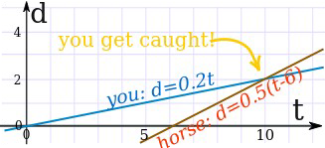
System of Linear Equations
•
So we have a system of equations (that are linear):
– d = 0.2t
– d = 0.5(t−6)
We can solve it on a graph:
•
•
Do you see how the horse starts at 6 minutes, but then runs faster?
It seems you get caught after 10 minutes ... you only got 2 km away.
Run faster next time.
•
•

Slide 49
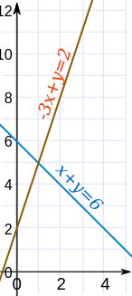
System of Linear Equations
•
•
There can be many ways to solve linear equations! Let us see another example:
Example: Solve these two equations: system linear equations graph
x + y = 6
−3x + y = 2
The two equations are shown on this graph: Our task is to find where the two lines cross.
Well, we can see where they cross, so it is already solved graphically.
•
•
•

Slide 50
System of Linear Equations
•
How to solve this? There can be many ways! In this case both equations have "y" so let's try subtracting the whole second equation from the first:
x + y − (−3x + y) = 6 − 2
Now let us simplify it:
x + y + 3x − y = 6 − 2 4x = 4
x = 1
•
•
So now we know the lines cross at x=1.

Slide 51
System of Linear Equations
•
And we can find the matching value of y using either of the two original equations (because we know they have the same value at x=1). Let's use the first one (you can try the second one yourself):
x + y = 6 1 + y = 6
y = 5
And the solution is:
x = 1 and y = 5
And the graph shows us we are right!
•
•

Slide 52
Linear Equations
Linear Equation
2x + y – z = 4
Non-Linear Equation 2x + y² – z = 4

Slide 53
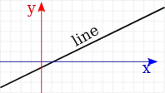
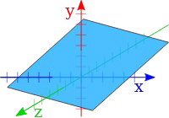
Dimensions
A Linear Equation can be in 2 dimensions ... (such as x and y)
... or in 3 dimensions ... (it makes a plane)

Slide 54
Variables
•
Common Variables
For the equations to "work together" they share one or more variables:
A System of Equations has two or more equations in one or more variables
Many Variables
So a System of Equations could have many equations and many variables.
Example: 3 equations in 3 variables
•
2x | + | y | − | 2z | = | 3
x | − | y | − | z | = | 0
x | + | y | + | 3z | = | 12

Slide 55
Variables
•
When the number of equations is the same as the number of variables there is likely to be a solution. Not guaranteed, but likely.
In fact there are only three possible cases:
No solution
One solution
Infinitely many solutions
When there is no solution the equations are called "inconsistent".
One or infinitely many solutions are called "consistent"
•
•
•
•

Slide 56
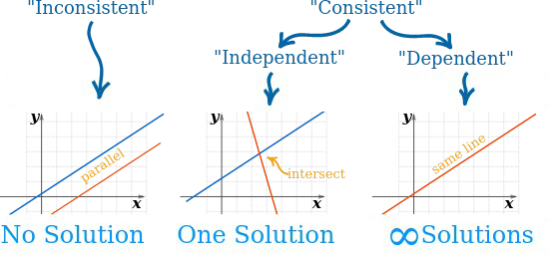
Variables
•
Here is a diagram for 2 equations in 2 variables:

Slide 57
Independent
•
"Independent" means that each equation gives new information. Otherwise they are "Dependent".
Also called "Linear Independence" and "Linear Dependence"
Example: x + y = 3
2x + 2y = 6
Those equations are "Dependent", because they are really the same equation, just multiplied by 2.
So the second equation gave no new information.
•
•
•
•

Slide 58
Where the Equations are True
•
•
•
•
•
The trick is to find where all equations are true at the same time. True? What does that mean?
Example: You versus Horse
The "you" line is true all along its length (but nowhere else).
Anywhere on that line d is equal to 0.2t
at t=5 and d=1, the equation is true (Is d = 0.2t? Yes, as 1 = 0.2×5 is true)
at t=5 and d=3, the equation is not true (Is d = 0.2t? No, as 3 = 0.2×5 is not true)
Likewise the "horse" line is also true all along its length (but nowhere else).
But only at the point where they cross (at t=10, d=2) are they both true.
•
•

Slide 59
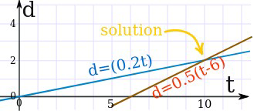
Where the Equations are True
Example...

Slide 60
Linear Independence
A set of vectors { v₁ , v₂ ,..., v_{k} } is linearly independent if the vector equation:
x₁ v₁ + x₂ v₂ + ··· + x_{k} v_{k} = 0
has only the trivial solution x₁ = x₂ = ··· = x_{k} = 0.
The set { v₁ , v₂ ,..., v_{k} } is linearly dependent otherwise.
•

Slide 61
Linear Independence
Facts about linear independence
Two vectors are linearly dependent if and only if they are collinear, i.e., one is a scalar multiple of the other.
Any set containing the zero vector is linearly dependent.
If a subset of { v₁ , v₂ ,..., v_{k} } is linearly dependent, then
{ v₁ , v₂ ,..., v_{k} }
is linearly dependent as well.
•

Slide 62
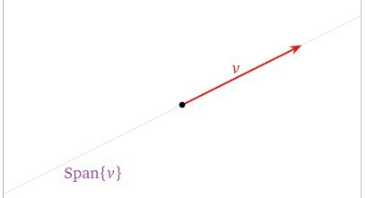
Picture of Linear Independence
•
A set containg one vector { v } is linearly independent when v != 0, since xv = 0 implies x = 0.

Slide 63
Matrix Factorization
•
Many complex matrix operations cannot be solved efficiently or with stability using the limited precision of computers.
Matrix decompositions are methods that reduce a matrix into constituent parts that make it easier to calculate more complex matrix operations.
Matrix decomposition methods, also called matrix factorization methods, are a foundation of linear algebra in computers, even for basic operations such as solving systems of linear equations, calculating the inverse, and calculating the determinant of a matrix.
•
•

Slide 64
Matrix Decompotition
•
A matrix decomposition is a way of reducing a matrix into its constituent parts.
It is an approach that can simplify more complex matrix operations that can be performed on the decomposed matrix rather than on the original matrix itself.
A common analogy for matrix decomposition is the factoring of numbers, such as the factoring of 10 into 2 × 5. For this reason, matrix decomposition is also called matrix factorization.
•
•

Slide 65
Matrix Decompotition
Types:
LU Decomposition
QR Decomposition
Comsky Decomposition
Eigen Decomposition

Slide 66
LU Decompotition
•
The LU decomposition is for square matrices and decomposes a matrix into L and U components.
A = L · U Or, without the dot notation. A = LU
Where A is the square matrix that we wish to decompose, L is the lower triangle matrix and U is the upper triangle matrix.
The factors L and U are triangular matrices. The factorization that comes from elimination is A = LU
•
•

Slide 67
LU Decompotition
•
The LU decomposition is found using an iterative numerical process and can fail for those matrices that cannot be decomposed or decomposed easily.
A variation of this decomposition that is numerically more stable to solve in practice is called the LUP decomposition, or the LU decomposition with partial pivoting.
A = L · U · P
•

Slide 68
LU Decompotition
•
The rows of the parent matrix are re-ordered to simplify the decomposition process and the additional P matrix specifies a way to permute the result or return the result to the original order.
There are also other variations of the LU. The LU decomposition is often used to simplify the solving of systems of linear equations, such as finding the coefficients in a linear regression, as well as in calculating the determinant and inverse of a matrix.
•

Slide 69
Eigen Decompotition
•
Eigendecomposition of a matrix is a type of decomposition that involves decomposing a square matrix into a set of eigenvectors and eigenvalues.
One of the most widely used kinds of matrix decomposition is called eigen decomposition, in which we decompose a matrix into a set of eigenvectors and eigenvalues.
•

Slide 70
Eigen Decompotition
•
A vector is an eigenvector of a matrix if it satisfies the following equation.
A · v = λ · v
This is called the eigenvalue equation, where A is the parent square matrix that we are decomposing, v is the eigenvector of the matrix, and λ is the lowercase Greek letter lambda and represents the eigenvalue scalar.
Or without the dot notation.
Av = λv
•
•

Slide 71
Eigen Decompotition
•
A matrix could have one eigenvector and eigenvalue for each dimension of the parent matrix.
Not all square matrices can be decomposed into eigenvectors and eigenvalues, and some can only be decomposed in a way that requires complex numbers. The parent matrix can be shown to be a product of the eigenvectors and eigenvalues.
A = Q · Λ · Q ^{T} Or, without the dot notation. A = QΛQ^{T}
Where Q is a matrix comprised of the eigenvectors, Λ is the uppercase Greek letter lambda and is the diagonal matrix comprised of the eigenvalues, and Q^{T} is the transpose of the matrix comprised of the eigenvectors.
•
•

Slide 72
Eigen Decompotition
•
Eigen is not a name, e.g. the method is not named after “Eigen”; eigen (pronounced eye-gan) is a German word that means own or innate, as in belonging to the parent matrix.
A decomposition operation does not result in a compression of the matrix; instead, it breaks it down into constituent parts to make certain operations on the matrix easier to perform.
Like other matrix decomposition methods, Eigendecomposition is used as an element to simplify the calculation of other more complex matrix operations.
•
•

Slide 73
Eigen Vector and Values
•
Eigenvectors are unit vectors, which means that their length or magnitude is equal to 1.0.
They are often referred as right vectors, which simply means a column vector (as opposed to a row vector or a left vector). A right-vector is a vector as we understand them.
Eigenvalues are coefficients applied to eigenvectors that give the vectors their length or magnitude. For example, a negative eigenvalue may reverse the direction of the eigenvector as part of scaling it.
A matrix that has only positive eigenvalues is referred to as a positive definite matrix, whereas if the eigenvalues are all negative, it is referred to as a negative definite matrix.
•
•
•

Slide 74
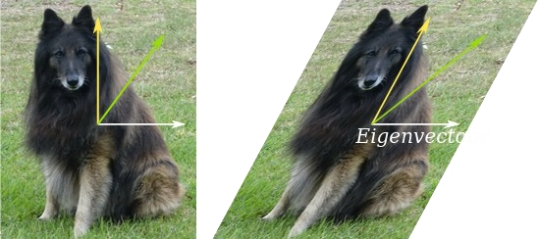
Eigen Vector and Values
•
•
They have many uses!
A simple example is that an eigenvector does not change direction in a transformation:

Slide 75
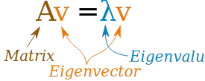
Eigen Vector and Values
•
For a square matrix A, an Eigenvector and Eigenvalue make this equation true:

Slide 76


Eigen Vector and Values : Example
•
Example: For this matrix
•
an eigenvector is:
•
with a matching eigenvalue of 6

Slide 77


Eigen Vector and Values : Example
•
Av gives us:
•
λv gives us :
•
Yes they are equal! So Av = λv as promised.

Slide 78
Eigen Vector and Values
Decomposing a matrix in terms of its eigenvalues and its eigenvectors gives valuable insights into the properties of the matrix.
Certain matrix calculations, like computing the power of the matrix, become much easier when we use the eigendecomposition of the matrix.

Slide 79
Confirm Eigen Vector and Values
We can confirm that a vector is indeed an eigenvector of a matrix.
We do this by multiplying the candidate eigenvector by the value vector and comparing the result with the eigenvalue.
First, we will define a matrix, then calculate the eigenvalues and eigenvectors.
We will then test whether the first vector and value are in fact an eigenvalue and eigenvector for the matrix.
Example...

Slide 80






Thank you
This presentation is created using LibreOffice Impress 5.1.6.2, can be used freely as per GNU General Public License
/mITuSkillologies
@mitu_group
/company/mitu- skillologies
MITUSkillologies
Web Resources https://mitu.co.in http://tusharkute.com
contact@mitu.co.in tushar@tusharkute.com

